Slide 1

COMPANY PROFILE
AT GLANCE
RC: 1458777
www.pentuimleap.com
…Quality And Efficient Services

Slide 2
Outline
Company Introduction
Mission Statement
Business practices and strategy
Drilling Support Services
Our Equipment
Why do business with us?
…Quality And Efficient Services

Slide 3
COMPANY INTRODUCTION
100%
Nigerian
Company
WE PROVIDE:
Solid Control and Waste Management Services to the E&P Companies.
We supply High pressure valves, flanges, spades & accessories directly from OEM.
Supply of Exploration and Borehole Rigs.
Offshore Security Surveillance.
Offshore Cargo Baskets/Containers/skids (DNV Certified).
Drilling Casing Pipes /Tubing.
Offshore Bunkering Of Vessels.
Vessel /Tank Cleaning.
Geophysical and Geotechnical Services.
Third Party Inspection Services.
Our Mode Of Operation Is To Exceed The Expectation Of Our Clients
…Quality And Efficient Services

Slide 4
MISSION STATEMENT
We strive to provide integrated operational services and waste management structure that addresses all the needs of your specific project. We also supply quality high pressure valves, flanges, spades & accessories from original equipment manufacturer, irrespective of the application, our project specific drilling support approach has shown the capacity to deliver:
High efficiency;
Lower drilling cost for our clients;
Reduced NPT rates;
Optimum HSE performance.
…Quality And Efficient Services

Slide 5
Our Business Practices/ Strategy
Safety first.
Quality of products
We recognize that each project and rig is unique.
Provision of environmental friendly waste management solutions which improve drilling rates and reduce cost.
Highly experienced personnel who are up to date on industry standards
Our value-added services and support programs maximizes uptime, simplify management, and deliver solid value.
We employ a closed loop system that minimizes waste
…Quality And Efficient Services

Slide 6
OUR OPERATIONS AND WASTE TREATMENT SERVICES
PENTIUM LEAP VENTURES LTD. in partnership with PRIME SOURCES LIMITED for treatment of various waste. And BST for exploration, borehole rigs and High pressure valves, flanges, spades & accessories
The operating characteristics of the thermal plant was also designed to accept apart from hydrocarbon contaminants, but also materials contaminated with coal tar constituents such as PAHs, phenols and pesticides including DDA, DDE and DDT.
The facility has been designed to ensure that oil is recovered from the waste while the solids are recovered as fine dusts.
…Quality And Efficient Services

Slide 7
The thermal plant was designed to ensure that air and noise emissions comply with regulatory limits. The process outputs are recorded graphically and tabulated on hourly basis on magnetic copy and a paper copy is produced for each 12-hour operational shift. The stack of the plant is fitted with catalytic bead filters to effectively remove particulates and metals from being emitted in the stack gases. The stack height is 12m above grade.

Slide 8
RESIDUE DISPOSAL
The treated materials will be re-hydrated and cooled as they are discharged to suppress dust production. They will be sampled on a regular basis during operation. The treated solids will be placed within one of the lined and bermed cells. The treated solids once confirmed by laboratory analyses to meet the applied criteria will be taken off site for any of the under listed beneficial end uses:

Slide 9
Industrial backfill;
Road sub-grade;
Asphalt incorporation;
Brick making;
Synthetic aggregate;
Concrete filler;
Landfill cover;
Low permeability under containment area; and
Blocks.

Slide 10
COMMON REASONS FOR DOWN TIME IN DRILLING OPERATIONS
Bad Equipments
Poor Logistics
Inexperienced Personnel
Unavailability of Spares on location
…Quality And Efficient Services

Slide 11
PLVL UNIQUE SOLUTIONS
All equipments are serviced and tested regularly
We have highly trained and experienced personnel executing our projects (We always go for the best hands in the industry)
Proactive in nature: We ensure that spares are made available on site.
To account for all eventualities, we have in place a
24hr logistics team
…Quality And Efficient Services

Slide 12
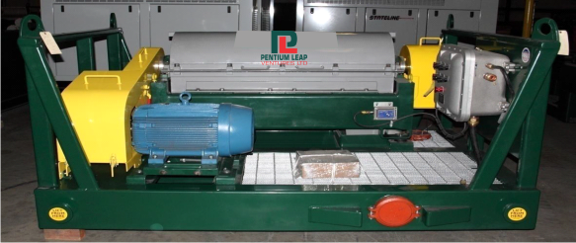
OUR EQUIPMENT (SOLIDS CONTROL)
Solids Control (Shale Shakers, Mud Cleaner, Shaker Screen, Decanting Centrifuges, Mud Mixing Systems)
Containment & Handling (Screw conveyors, High-powered and portable-vacuum units, Tank-cleaning systems, Cuttings containers, Waste pit liners, Offshore cuttings tank)
Recycling and recovery (drying shaker, Vertical and horizontal centrifugal dryers)

Slide 13
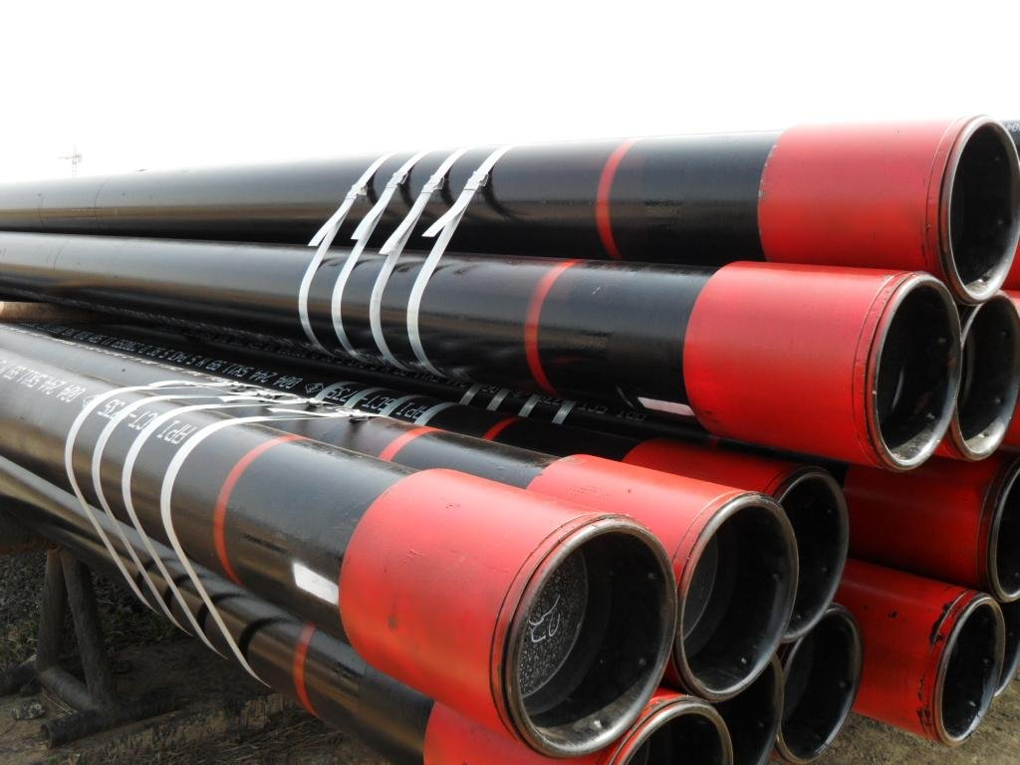
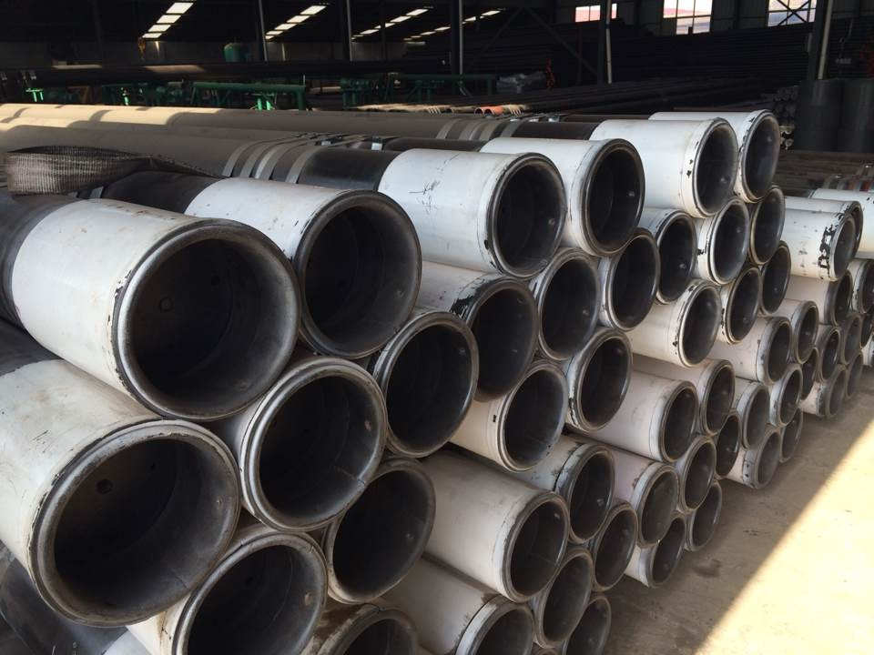
OUR EQUIPMENT (CASING PIPES)
Delivers high quality performance
in every project.
We offer reliable field-proven technology for every drilling application.
We specialize in providing high-capacity equipment with small footprint features that are ready for rapid deployment to meet your most demanding technical challenge.
…Quality And Efficient Services

Slide 14
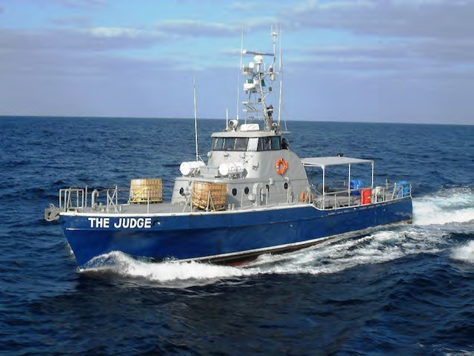
OUR EQUIPMENT (SECURITY)
…Quality And Efficient Services

Slide 15
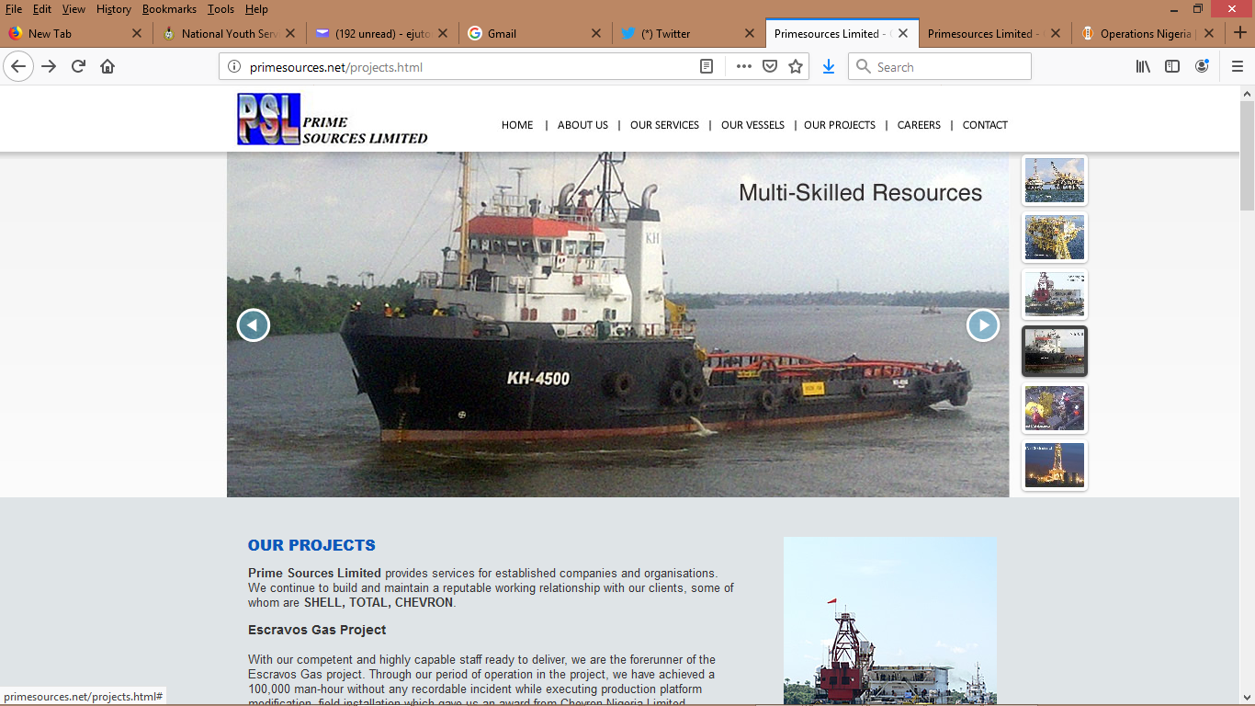
PICTURES OF OUR MARINE EQUIPMENT (PARTNERSHIP –PRIME SOURCES LTD.)
…Quality And Efficient Services

Slide 16
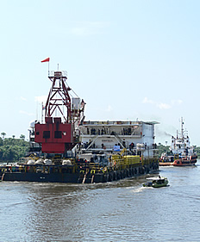
PICTURES OF OUR MARINE EQUIPMENT (PARTNERSHIP –PRIME SOURCES LTD.)

Slide 17
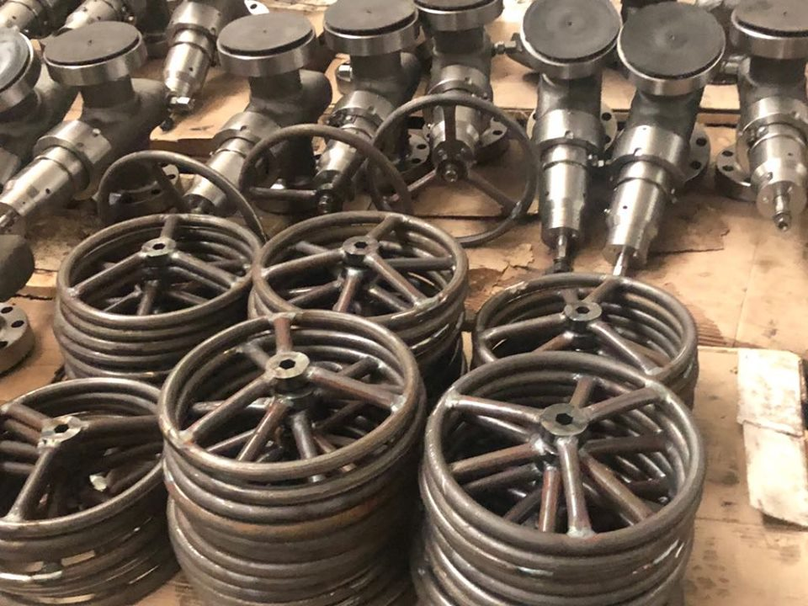
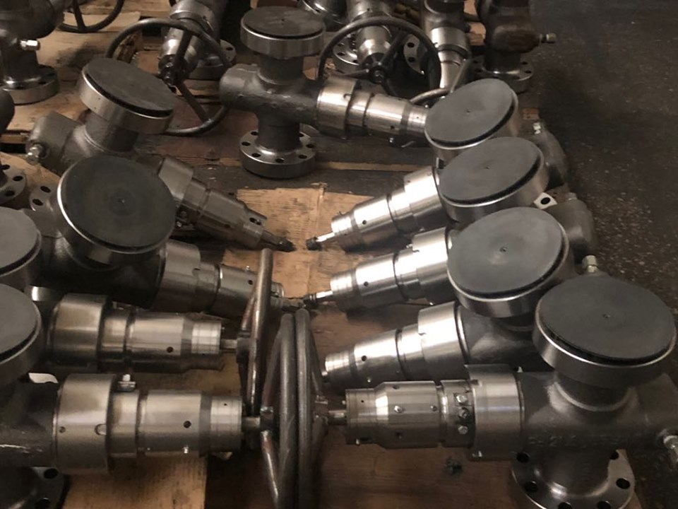
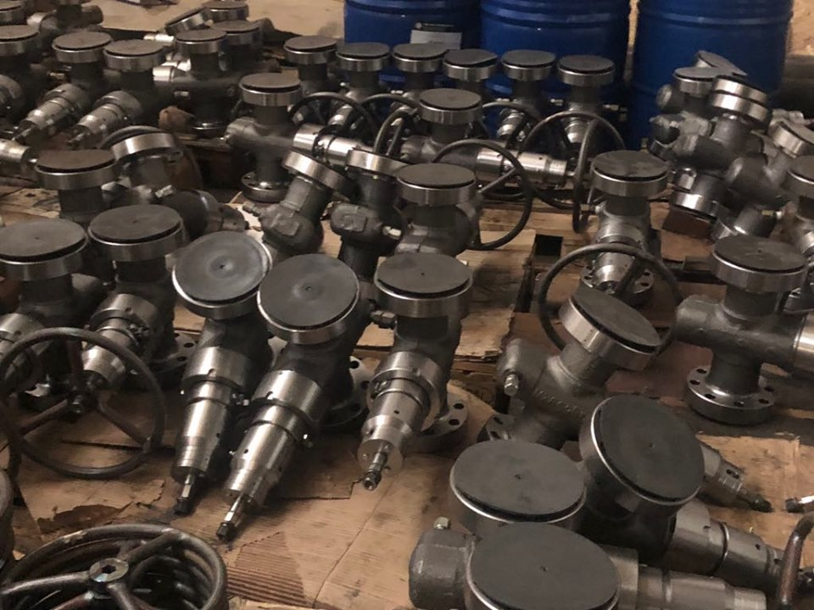
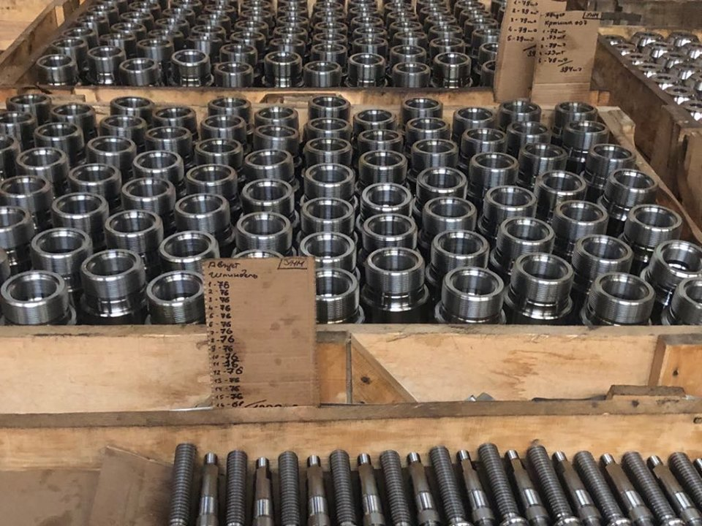
High pressure valves, flanges, spades & accessories
Signed Partnership agreement with OEM

Slide 18
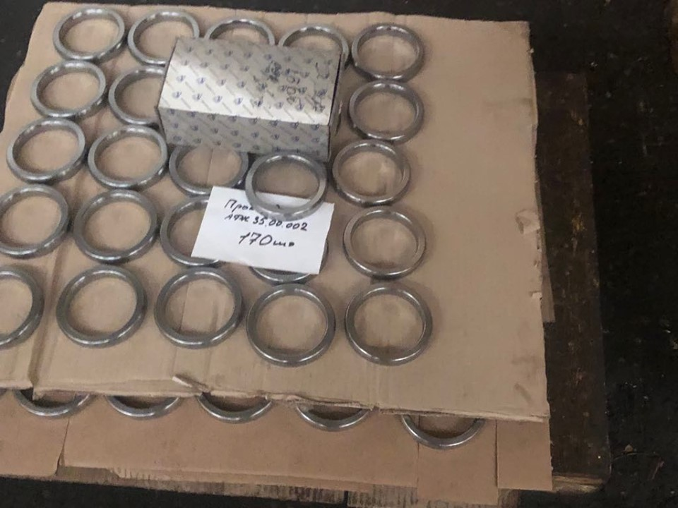
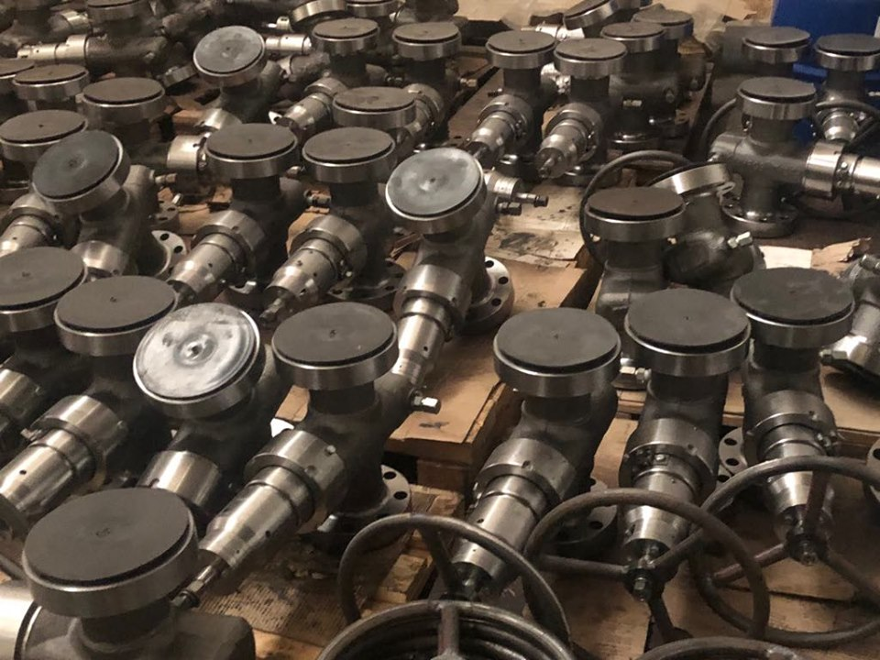
HIGH PRESSURE VALVES, FLANGES, SPADES & ACCESSORIES.
Signed Partnership agreement with OEM

Slide 19
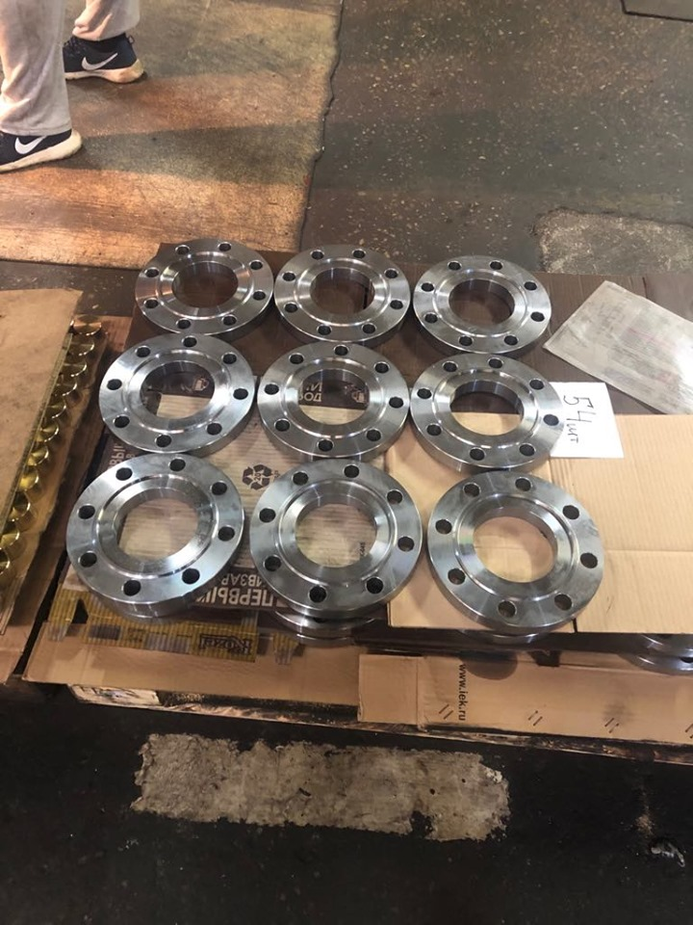
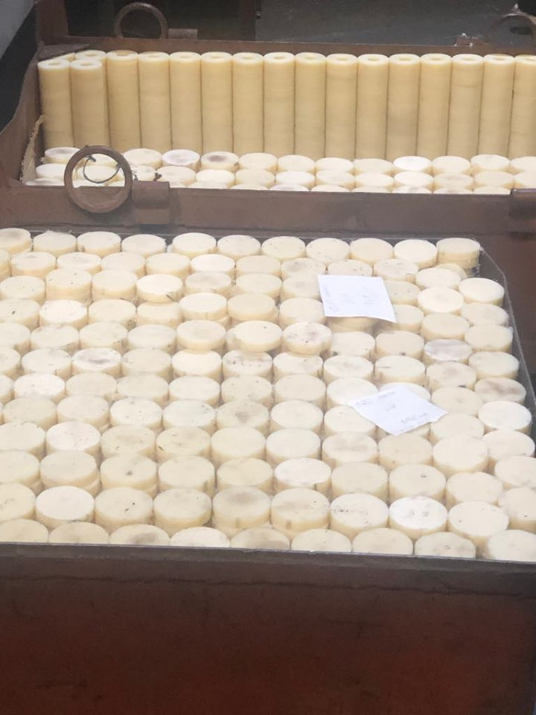
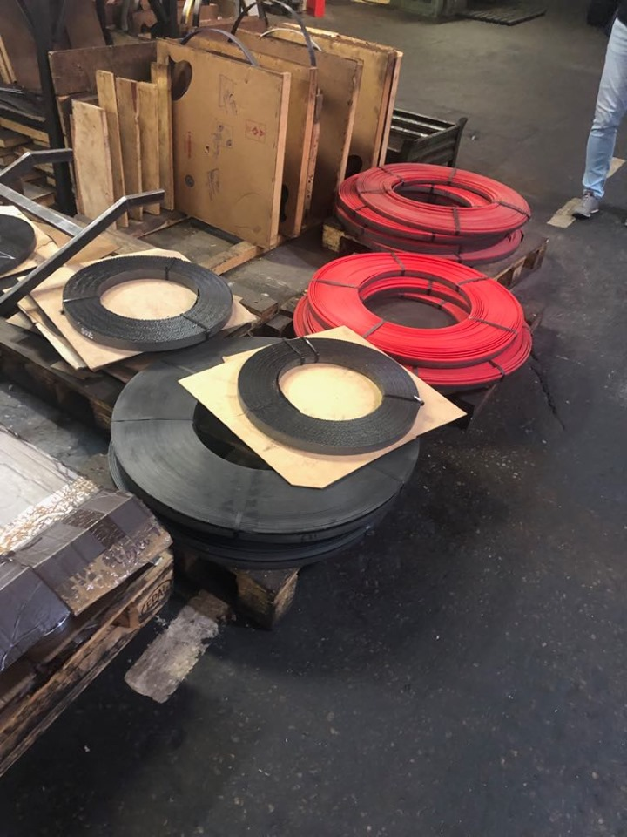
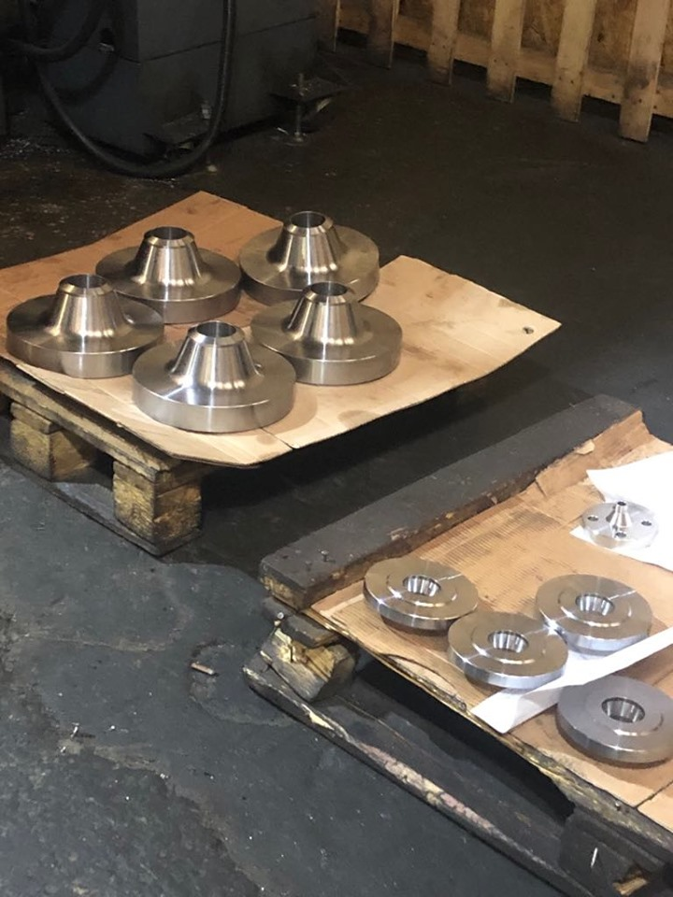
HIGH PRESSURE VALVES, FLANGES, SPADES & ACCESSORIES
Signed Partnership agreement with OEM

Slide 20
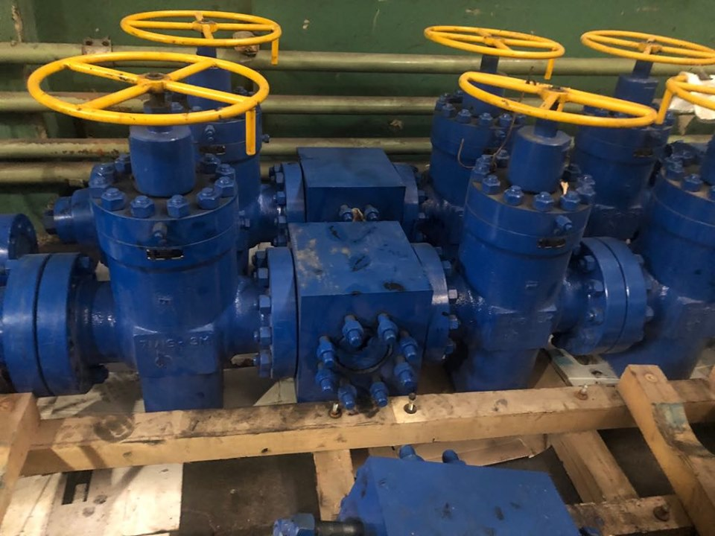
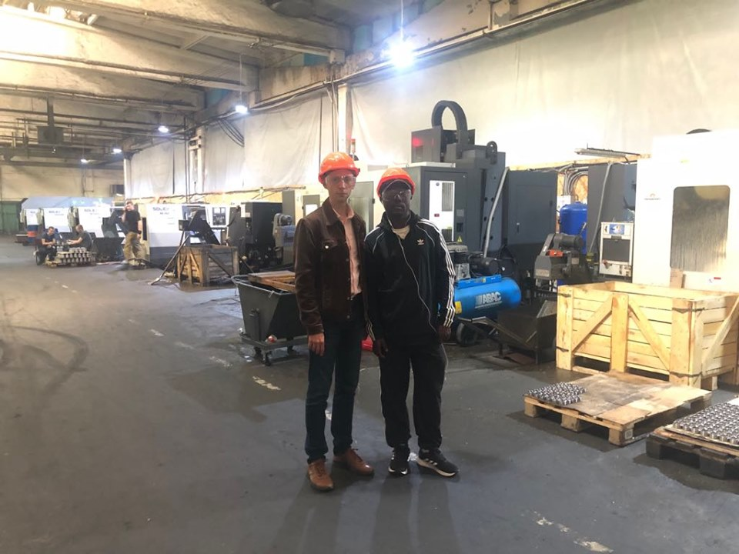
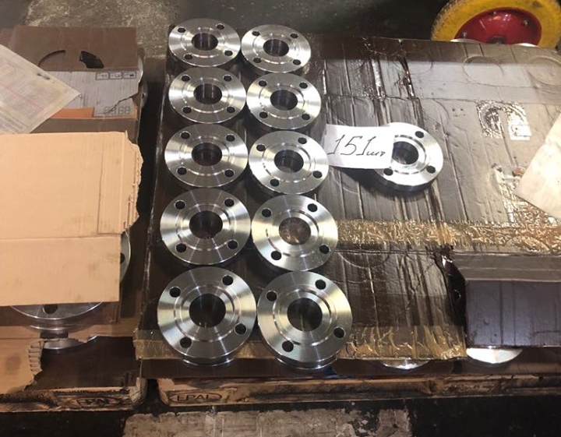
HIGH PRESSURE VALVES, FLANGES, SPADES & ACCESSORIES
Signed Partnership agreement with OEM

Slide 21
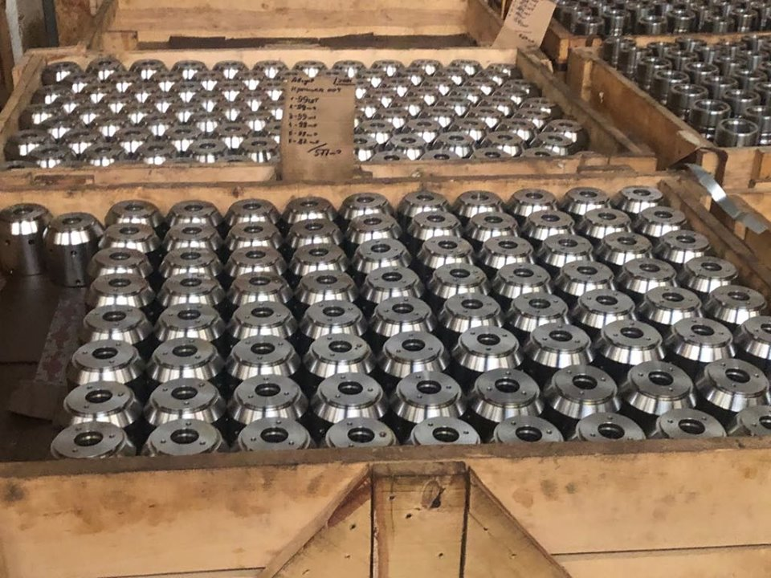
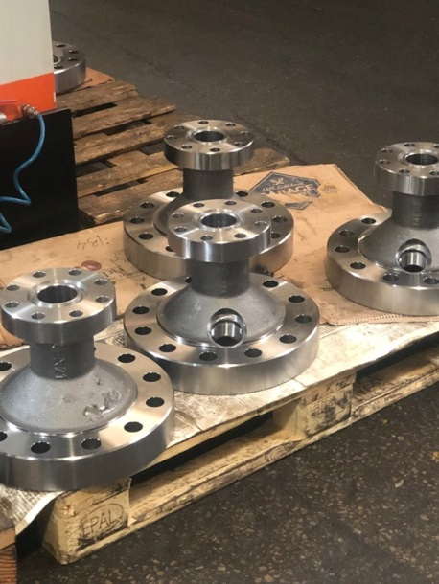
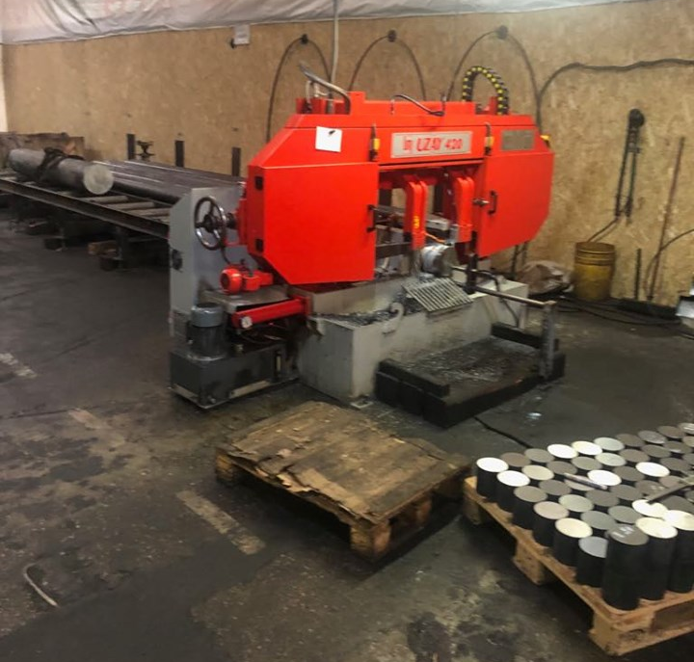
High pressure valves, flanges, spades & accessories
Signed Partnership agreement with OEM

Slide 22
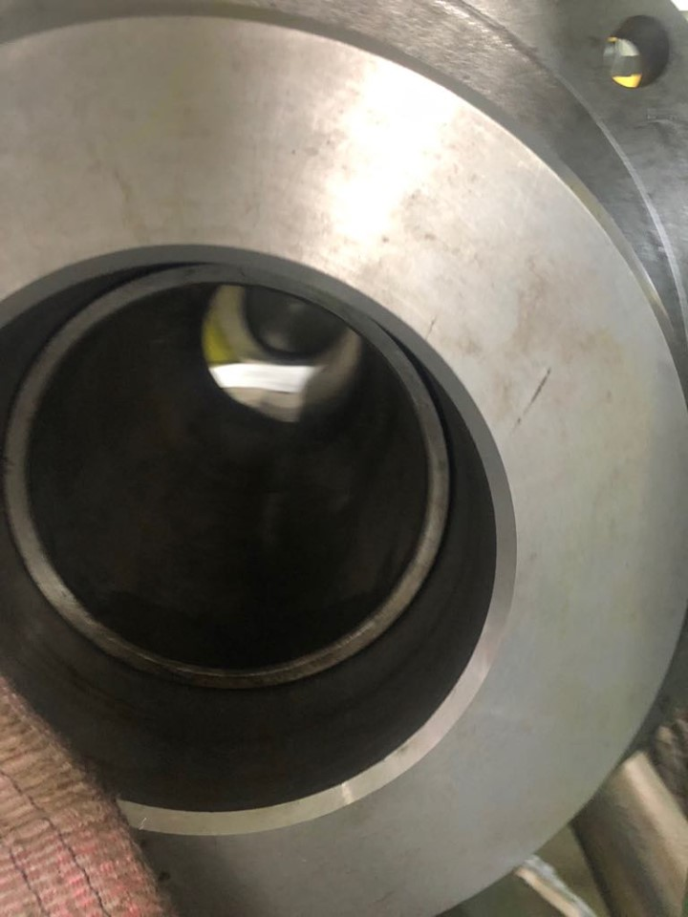
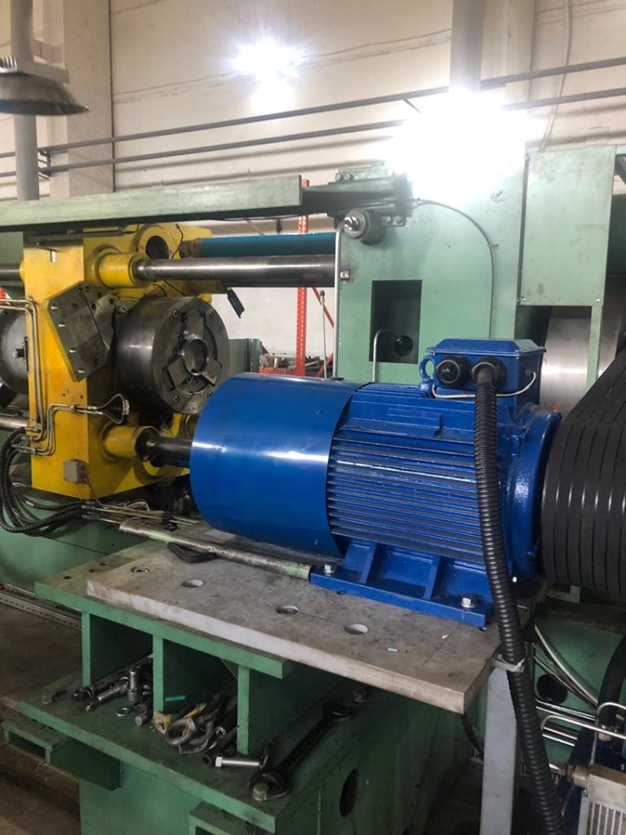
HIGH PRESSURE VALVES, FLANGES, SPADES & ACCESSORIES
Signed Partnership agreement with OEM

Slide 23
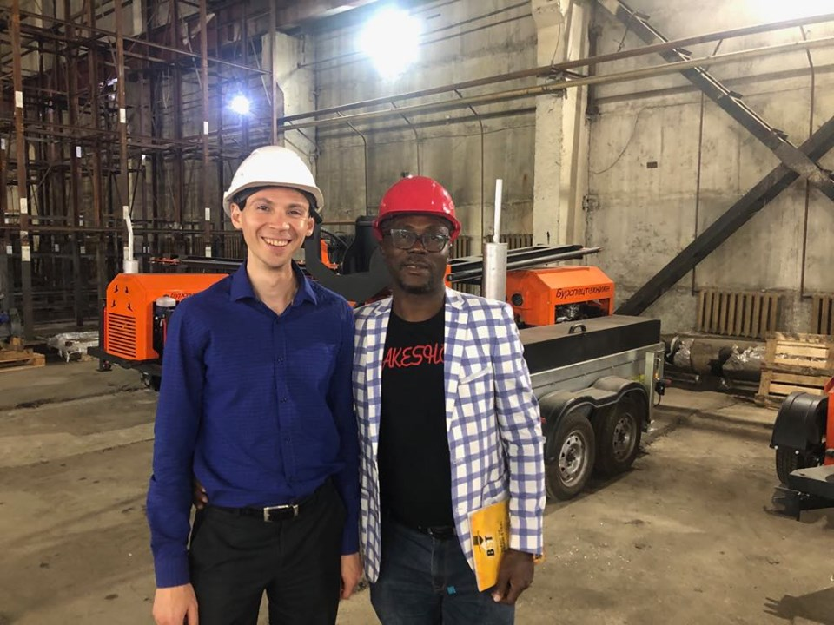
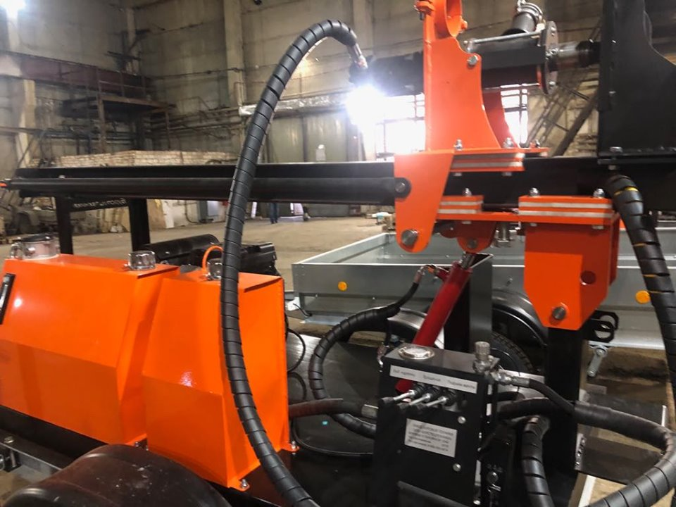
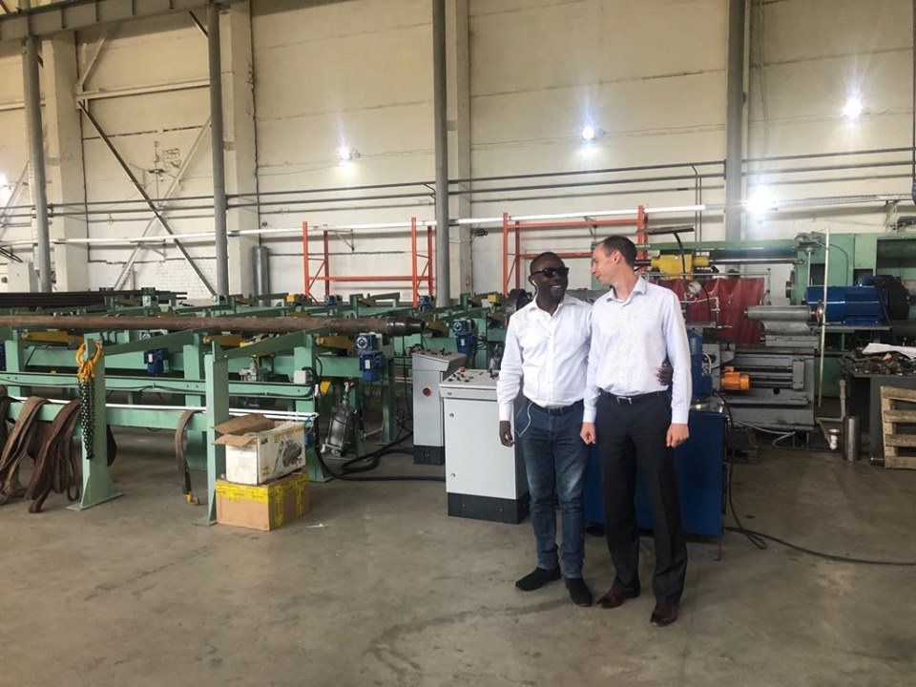
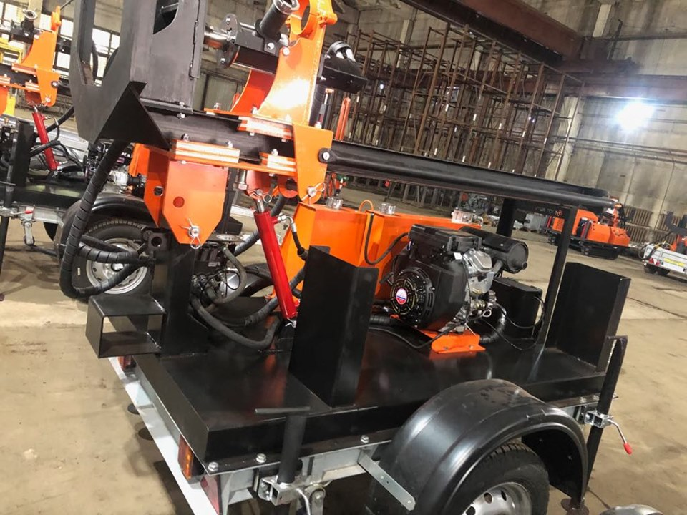

Slide 24
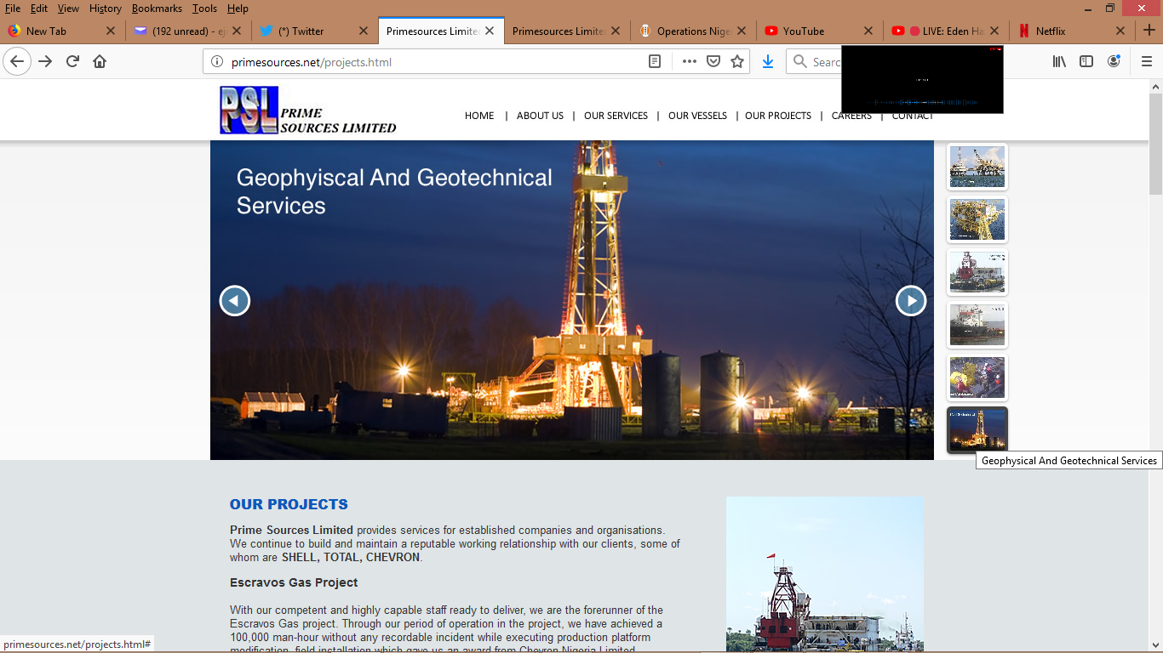
GEOPHYSICAL AND GEOTECHNICAL SERVICES
(Partnership Prime sources LTD)

Slide 25
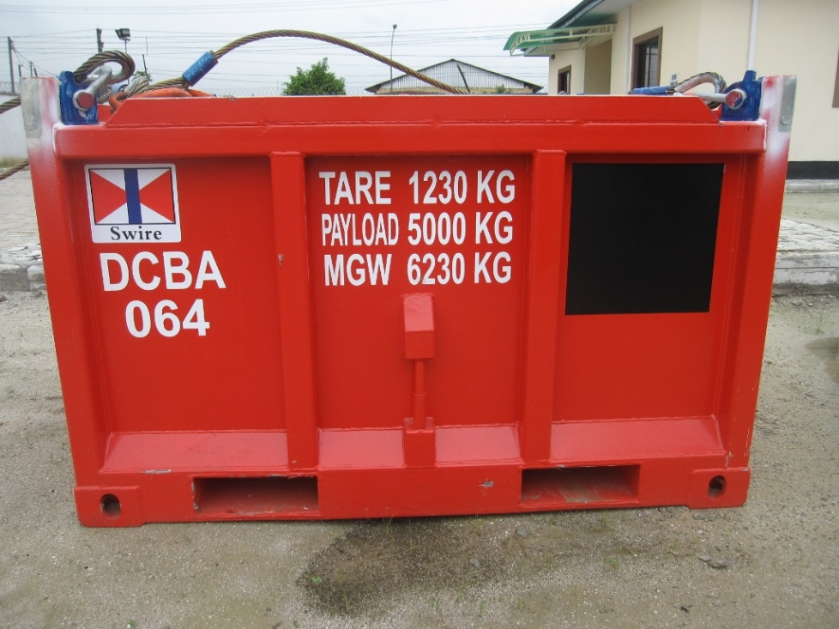
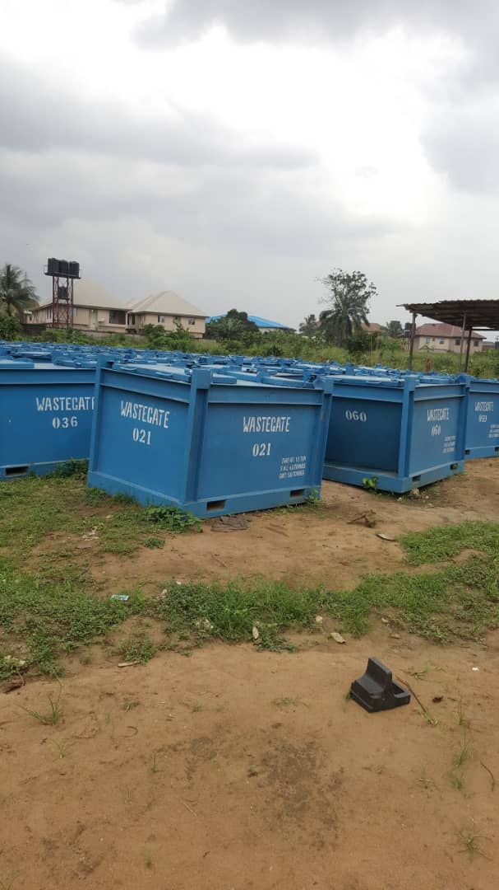
PICTURES OF OUR EQUIPMENT
…Quality And Efficient Services

Slide 26
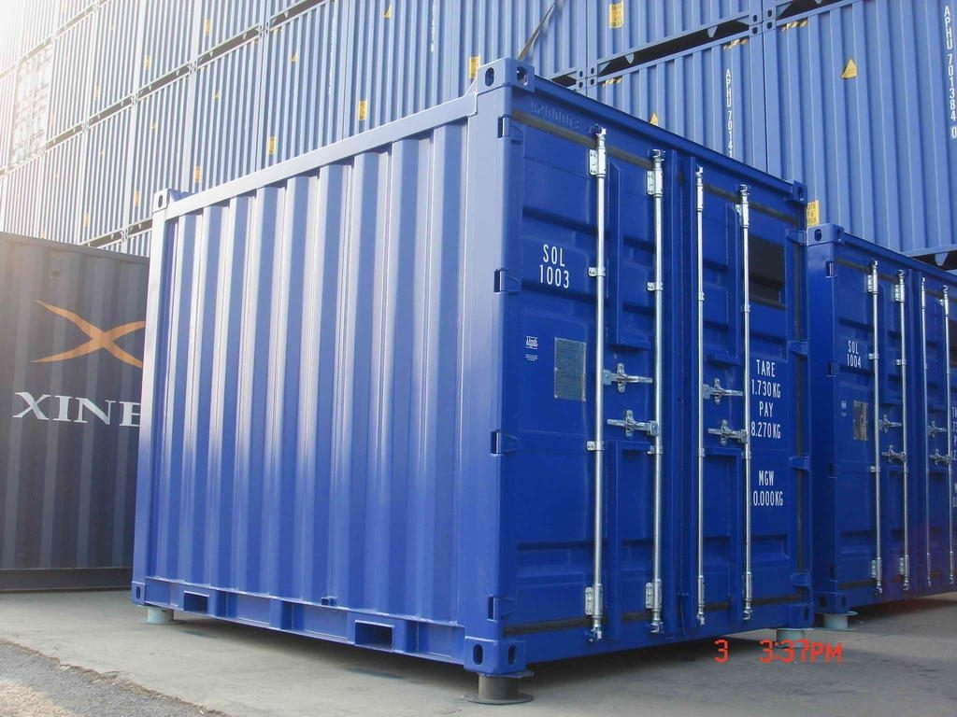
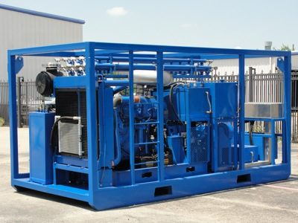
EQUIPMENT
…Quality And Efficient Services

Slide 27
RC: 1458777
129 Abuloma Road, Port Harcourt,
Rivers Stat, Nigeria
Email: info@pentiumleap.com,
pentiumleap@yahoo.com
Tel:+2348035561738, +2348073497119
TDU Operational Site:
KM 17 Aba/Ph Express Road,
Oyigbo
Port Harcourt, Rivers State.
Contact
www.pentuimleap.com
…Quality And Efficient Services

